Slide 1


EDULEAD
Cloud based ERP solution for Educational Institutes
SUSTAINANLE OUTREACH AND UNIVERSAL LEADERSHIP (SOUL) Limited
© Copyright SOUL LIMITED

Slide 2









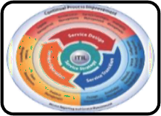


About SOUL Limited
SOUL Limited is the sister concern of KIIT’s which executes Strategy Consulting for Business transformation focused on sustainability through operational efficiency and capital productivity; using delivery process realignment, skill restructuring, smart negotiation, and contracting.
Our Insights:
Smart campus solutions using IoT and AI.
Skilled human resources for operation and maintenance of solar appliances.
Deployment of Enterprise Applications for
governance of University.
Sustainable engagement in core strategy,
operational and technical development.
Design and deployment of education aids.
IT infrastructures support to organizations as per ITIL standards.
Sustainable Healthcare, Modernizing Agriculture, Skill development in manufacturing, Disability Cluster.
Robotics-Aiding institutions with humanoids for contactless services.
© Copyright SOUL LIMITED

Slide 3










Introduction to SOUL
CERTIFICATION
MSME certified micro industry with UDYAM Registration No.-
UDYAM-OD-19-008646
Energy & Smart Infrastructure
Education
ISO Certified – ISO 9001:2015, ISO/IEC 20000-1:2018, ISO/IEC 27001:2013 & ISO 14001:2015
Meaningful and sustainable solutions
Skill
Development
IT & ITES
EMPANELMENT
Broadcat Engineers Consultants India Limited
Health and Social Wellness
Agriculture
Bharat Sanchar Nigam Limited
Rural Development
Partnership
© Copyright SOUL LIMITED

Slide 4









KIIT - The Leader in Education
India’s first QS 5 Stars Rated University
90+
Projects
No 1 among the private higher education Indian Universities
1921+
Publications
21st in India Rankings by NIRF
2500
Researchers
SOUL will leverage skillsets and research outcomes to build world class products and services for its distinguished clients.
30K
Students
© Copyright SOUL LIMITED

Slide 5

KIIT - SOUL Association
SOUL as the associate consultant of KIIT
SOUL is authored with the rights to use the financial and experiential credentials of KIIT
KIIT and SOUL
share financial gains for the executed projects
KIIT=SOUL
SOUL can deploy the faculties, research scholars
, ground staff of KIIT as its own resource
5
© Copyright SOUL LIMITED

Slide 6

















EDULEAD: Enterprise Resource Planning
Admission
Academics
Student Management
Fee Management
Exam Management
Hotel & Restaurant
Payment Gateway
Bio-metric Integration
SMS & Email Notifications
Support
Learning Management System
Healthcare
Accounting
Agriculture Farm Management
HR Management
Materials Management
Payroll
© Copyright SOUL LIMITED

Slide 7


EDULEAD : Modules
EduLead is a cloud based ERP Solution for educational institutes, with portals facilitating Student, Parent, Teacher and Management interactions and admin modules for the complete management of the day to day activities of educational institutes.
Student Life Cycle Management
Accounting
Human Resource Management
Payroll
Material Management
Hospitality
Agriculture
Healthcare
Support
Learning Management System
© Copyright SOUL LIMITED

Slide 8



SLCM
Re-registration
Registration
Alumni & Alma- matter
Admission
Student Master Data
Recruitment
Admission Application
Student Life Cycle Management
Tools
Academics
Student Exchange Program
Reporting
Academic
structure
Examination
Academic Calendar
Exams
Exam Management
Fees management
Course Scheduling
Course Scheduling
Attendance
Course Scheduling
Progression
© Copyright SOUL LIMITED

Slide 9
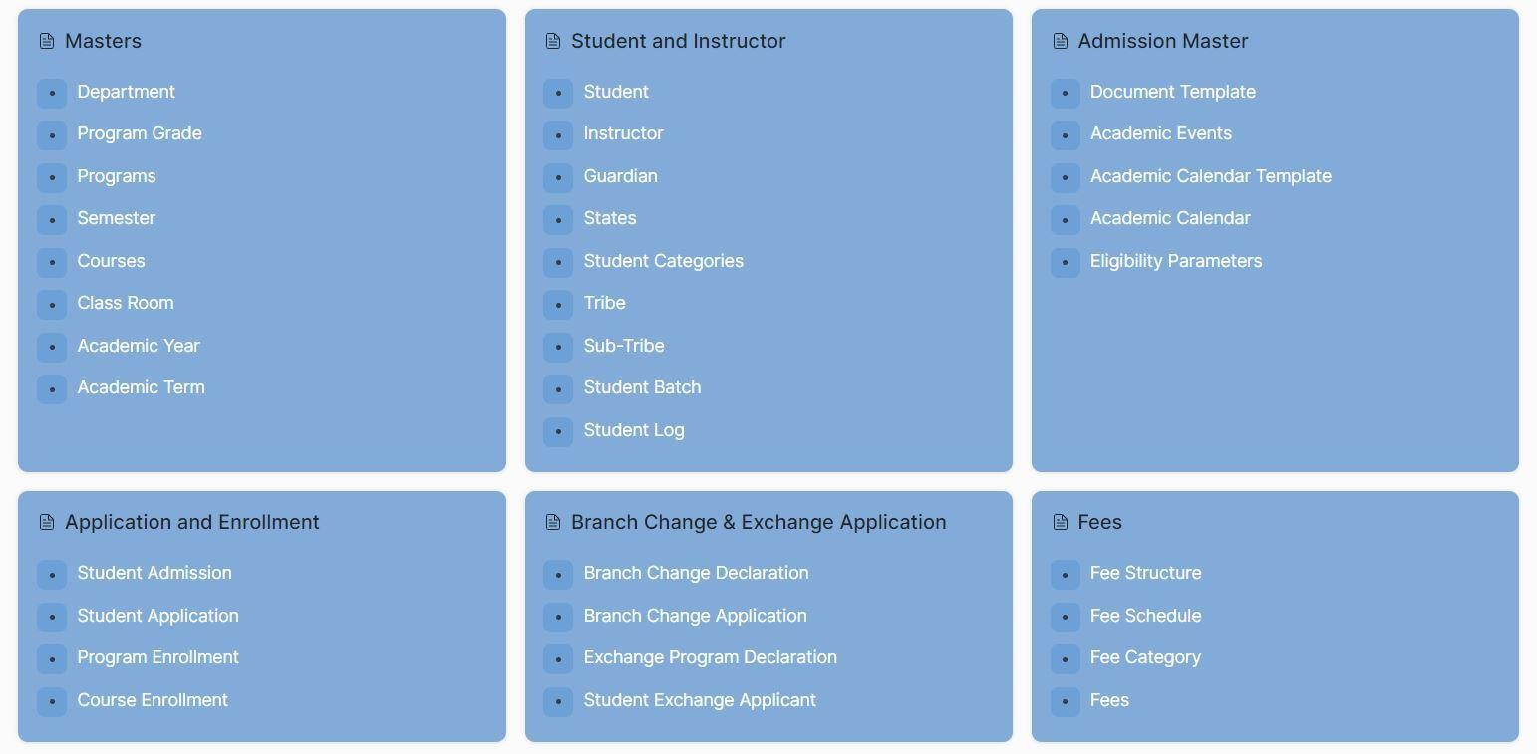
SLCM
© Copyright SOUL LIMITED

Slide 10
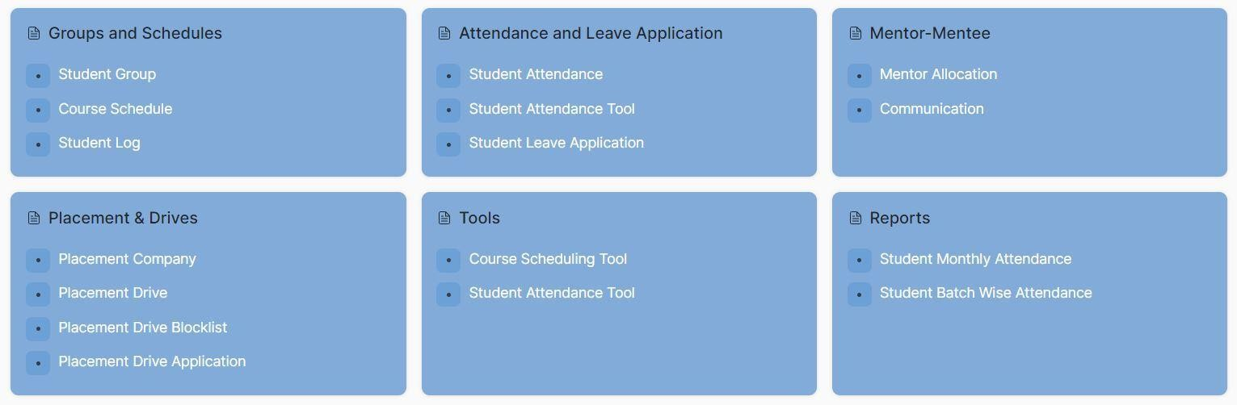
SLCM
© Copyright SOUL LIMITED

Slide 11
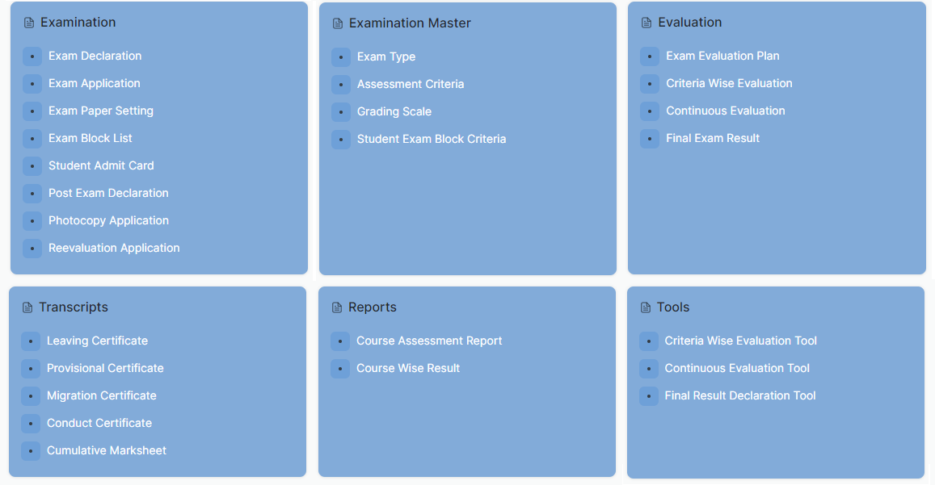
SLCM
© Copyright SOUL LIMITED

Slide 12






Human Resource Management
Employee Data
Management
Salary
Administration
Employee
Self-Service
Human Resource Management
Leave
Management
Payroll
Training & Skill
Development
Performance Based Appraisal System
© Copyright SOUL LIMITED

Slide 13
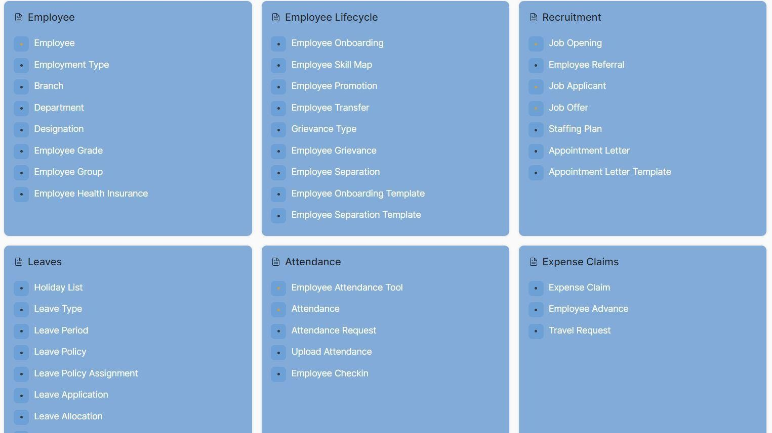
HRM
© Copyright SOUL LIMITED

Slide 14
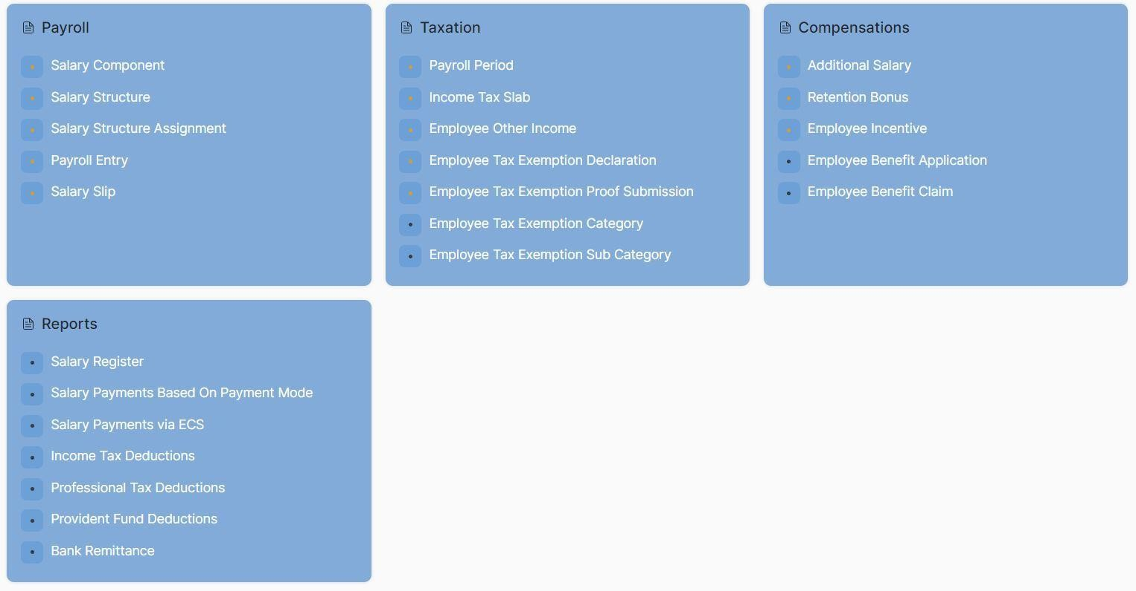
HRM
© Copyright SOUL LIMITED

Slide 15
Material Management
Purchase
Requisition
Payment
Process
RFP
Material Management
Invoice Verification
Vendor
Evaluation
Good
Receipt
Purchase
Order
© Copyright SOUL LIMITED

Slide 16
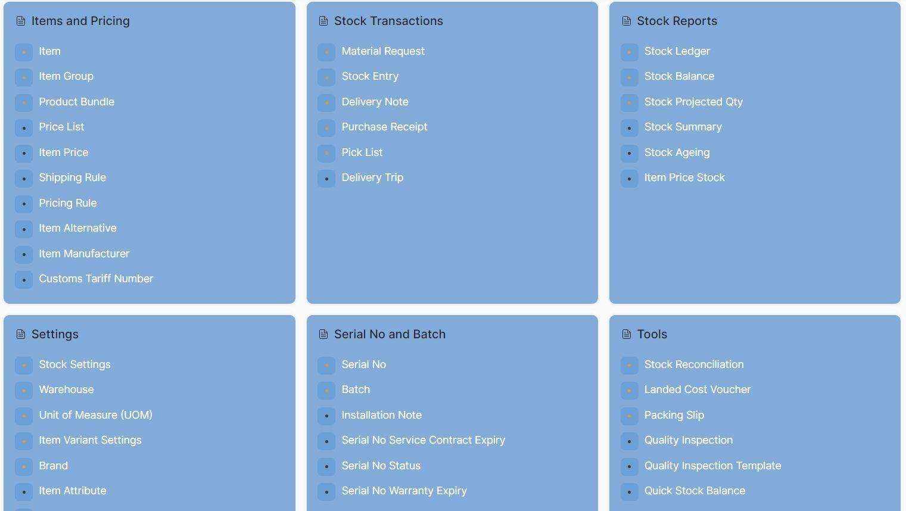
M
A
T
E
R
I
A
L
M
A
N
A
G
E
M
E
N
T
© Copyright SOUL LIMITED

Slide 17
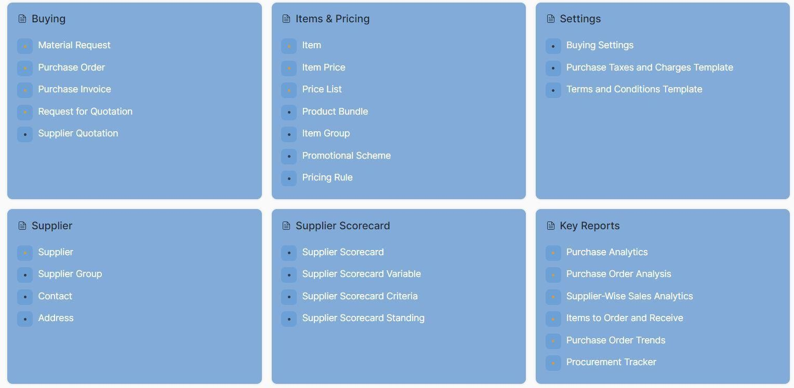
M
A
T
E
R
I
A
L
M
A
N
A
G
E
M
E
N
T
© Copyright SOUL LIMITED

Slide 18
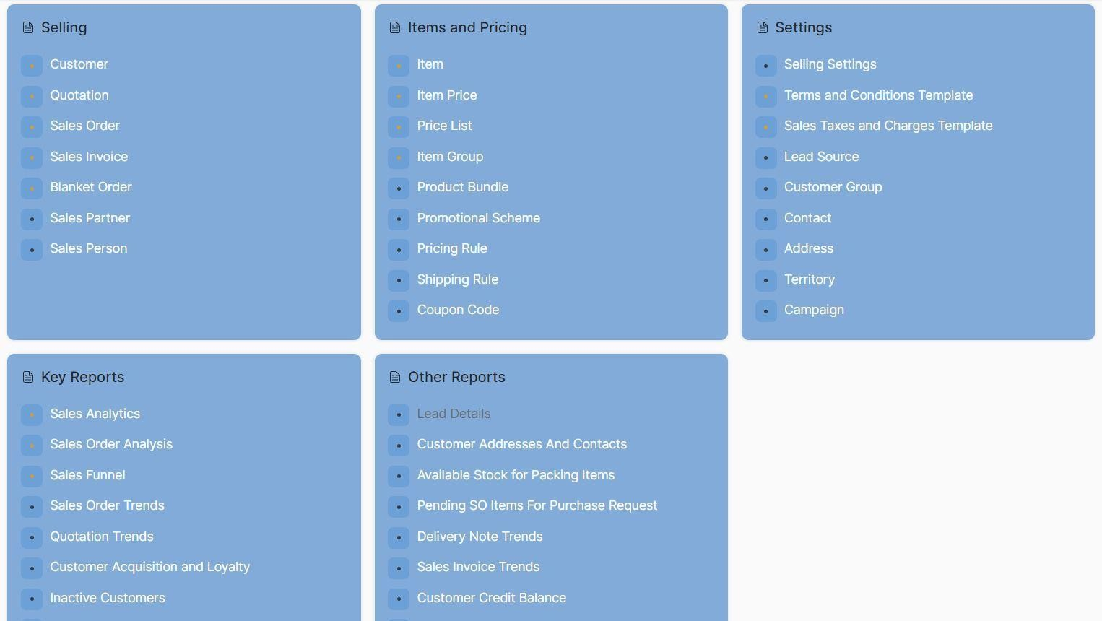
M
A
T
E
R
I
A
L
M
A
N
A
G
E
M
E
N
T
© Copyright SOUL LIMITED

Slide 19
Accounting
Accounting Masters
Cost Centre & Budgeting
General Ledger
Share Management
Accounting
Accounts Receivable
Goods &
Service Tax
Accounts
Payable
Subscription Management
Reports
Bank Statement
Financial
Statements
Settings
Multi Currency
© Copyright SOUL LIMITED

Slide 20
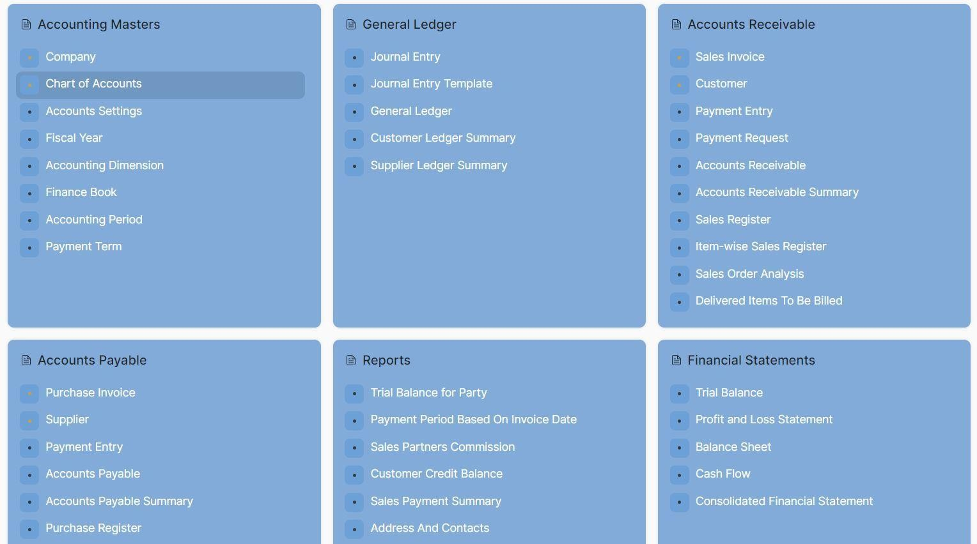
A
C
C
O
U
N
T
I
N
G
© Copyright SOUL LIMITED

Slide 21
Hospitality
Hotel Reservation
Customer Check out
Customer Check in
Hospitality
Restaurant Reservation
Hotel Payment Entry
Hotel Guest
Hotel Room

Slide 22
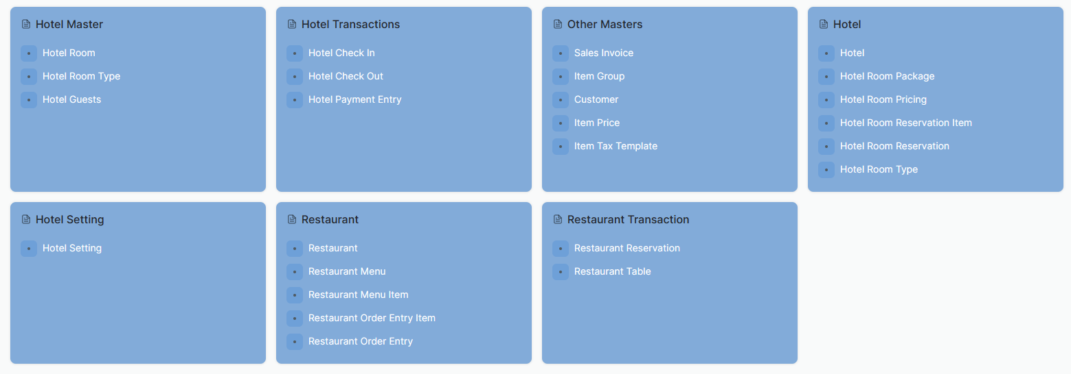
H
O
S
P
I
T
A
L
I
T
Y
© Copyright SOUL LIMITED

Slide 23
Healthcare
Patient
Appointment
Healthcare Setting
Prectitioner Schedule
Patient History
Healthcare
Patient Encounter
Healthcare Payement Entry
Prescription Dosage
Patient Progress
Patient Admission
Inpatient Medication Entry
Therapy Session
Sample Collection
Lab Test
© Copyright SOUL LIMITED

Slide 24
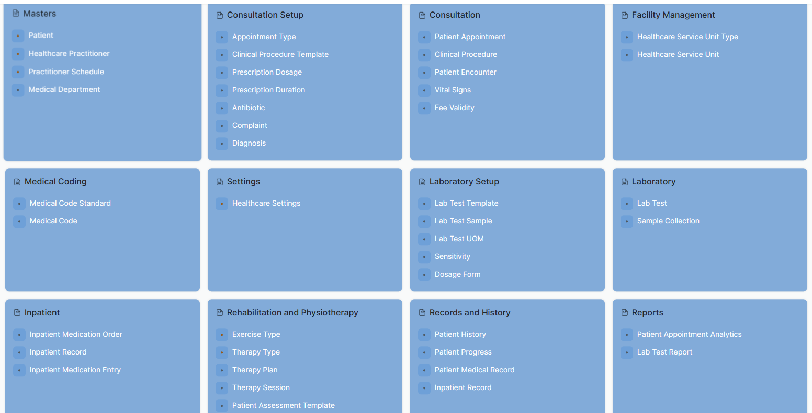
H
E
A
L
T
H
C
A
R
E
© Copyright SOUL LIMITED

Slide 25
Agriculture
Farm Management
Agriculture
Plant Management
Analysis
Medicine Management
Growth Management

Slide 26
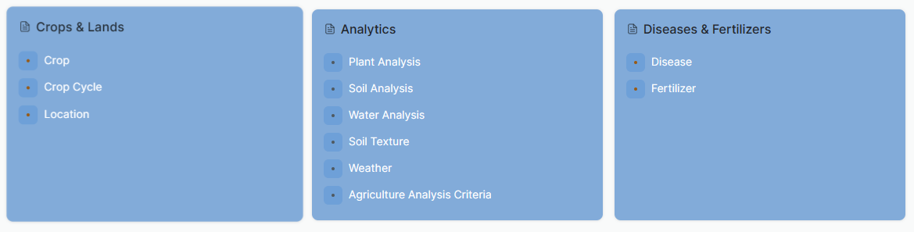
A
G
R
I
C
U
L
T
U
R
E
© Copyright SOUL LIMITED

Slide 27
Support
Issue
Support
Service Level Agreement
Notification/Email
Task Assignment
Issue Status
Maintenance Schedule/Visit

Slide 28
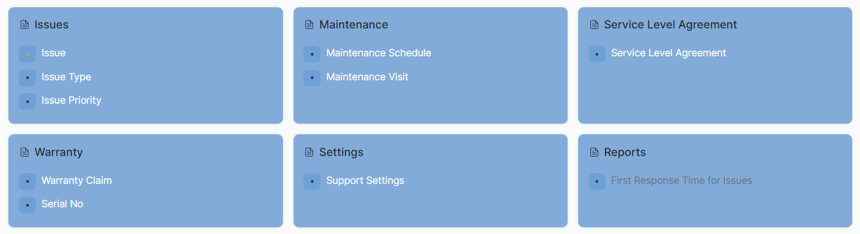
S
U
P
P
O
R
T
© Copyright SOUL LIMITED

Slide 29
EDULEAD Analytical Dashboard
© Copyright SOUL LIMITED

Slide 30




EDULEAD Analytical
Business Objective
Process
Outcome
Determine the performance of student and information where students excel or have difficulties with
Smarter or better attendance tracking
Enrolment probabilities to allow university have higher recruitment yield
Historical information of students (present and past) that stores demographics, student history and attendance population in a data warehouse
Single source of truth for master data (Student, Teachers, Courses) using intelligent deduplication techniques
Integrated predictive and prescriptive intelligence that targets students, teachers and management for optimal outcome from courses offered
Better outcomes for students resulting from mass customization of courses
Better outcome for teachers to understand learning methodology that works for students
Provides a holistic learning
and teaching environment
© Copyright SOUL LIMITED

Slide 31
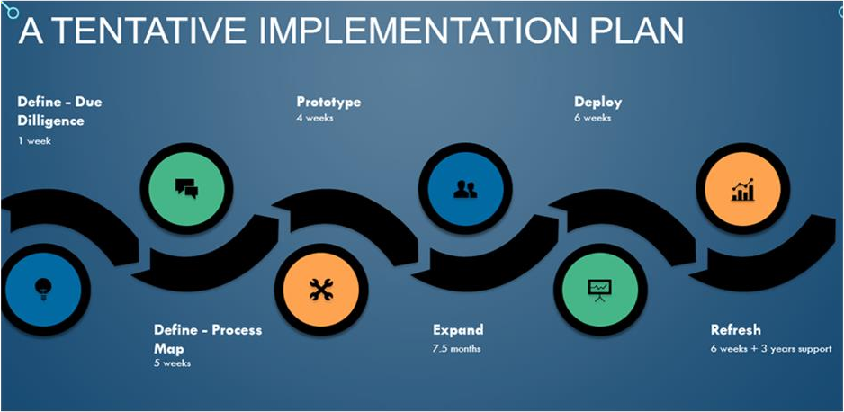



The Implementation Methdology
Key Principles
Our Agile based delivery methodology is based on certain cornerstones which make the delivery predictable and risk management easier.
Early Value: User story or requirement prioritization to create core solutions first in early sprints.
Sprint with Early Feedback: Development sprint followed by a testing sprint
Automation: Find out levers for automation to reduce time for manual or processes which are no longer required.
© Copyright SOUL LIMITED

Slide 32








EDULEAD: Advantages
Dynamic Automation & Support Services
Security & Surveillance
Robust Customization
User Friendly
VAPT & SAST certified
Cloud based solution
Design for unproblematic scalability
Low-Cost
Customization
Bulk data import facility
SMS, Payment Gateways and Bio metric System Integration Options available
Completely automated, accessed from anywhere in globe
Dynamic reports, customizable for institution needs
Support round the clock
Access to a forum common to students and parents
User friendly interface requiring minimal prerequisite knowledge
Effective communication between teachers and students
© Copyright SOUL LIMITED

Slide 33
Reference Implementations
The EduLead software has been implemented at the Kalinga Institute of Social Sciences (KISS).
The very first organization to join the clientele of EduLead is the famous institute for indigenous people, KISS, with successful completion of the training for all the end users. This implementation reduced the paperwork by the organization considerably while handling a crowd of 800 end users efficiently. The organization is also able to evaluate students based on continuous valuation which shall help it to get the accreditation from NAAC.
© Copyright SOUL LIMITED

Slide 34
Reference Implementations
Workflow based Invoice Tracking system for Kalinga Institute of Medical Sciences
The web based module is hosted on cloud with high security using SSL and RBAC providing cloud based reporting tools
Following business features are available as below:-
Workflow management
File Management
© Copyright SOUL LIMITED

Slide 35
Reference Implementations
PMU software for Bihar Education Public Council(BEPC)
Web based application to conduct survey and collect data and provide inputs for workforce management for Implementation in more than 2000 class rooms
Ability to plan and monitor the project implementation
Various dashboard for different stakeholders
© Copyright SOUL LIMITED

Slide 36




Thank you !
SOUL ® ©
Serving the society with meaningful and sustainable solutions
Ground Floor, New Block, Campus 1, Near Allahabad Bank, KIIT Patia, Bhubaneshwar – 751024
• +91 (0) 7077769334/ 35/ 36,
soul@soulunileaders.com
© Copyright SOUL LIMITED

